Slide 1
Unit 9 Electromagnetism
Part A: Fascinating Magnets

Slide 2
What will you learn?
Where can a magnet be useful to us?
What properties does a magnet have?
What materials process magnetic properties?
How to magnetize a ferromagnetic material?
How to demagnetize a ferromagnetic material?
How to store a magnet?

Slide 3

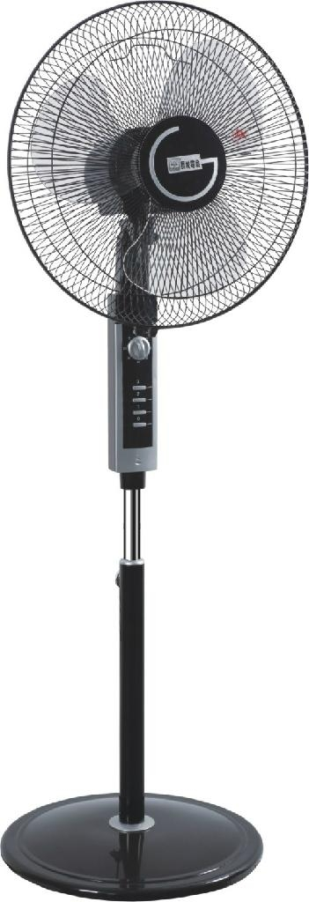
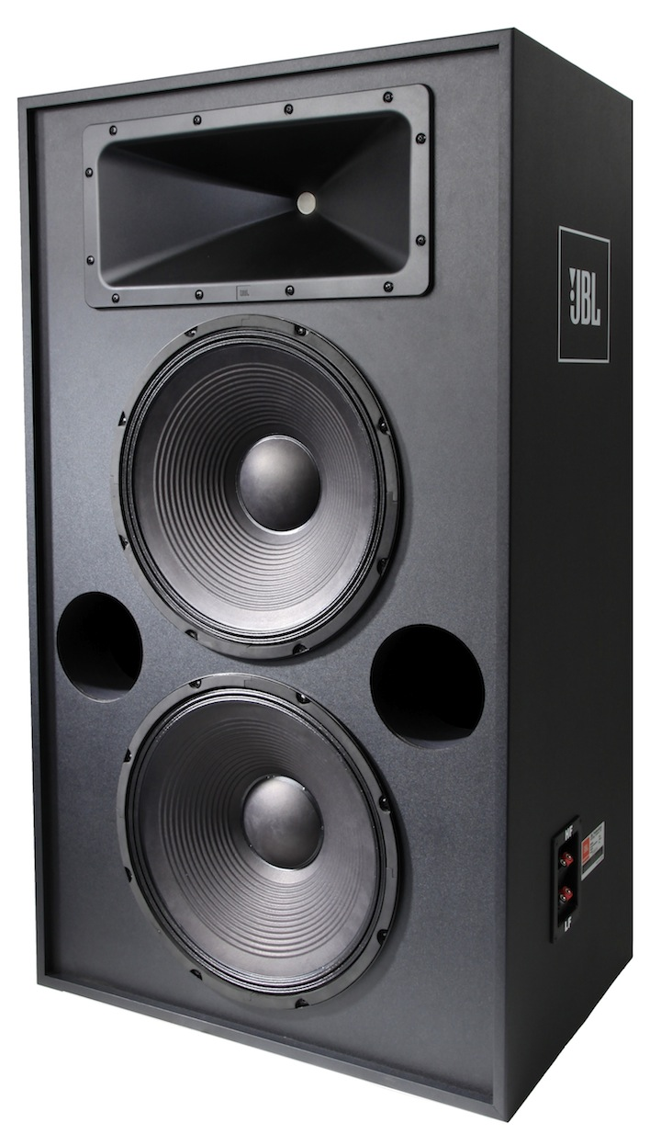
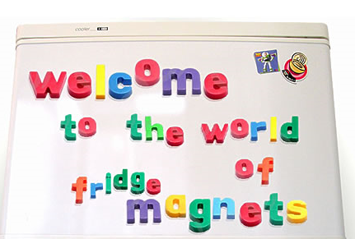
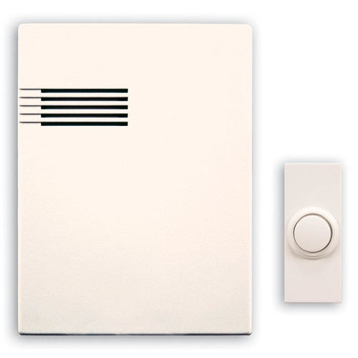
Magnets are needed to keep us active:
When you sing or speak through a mike to a vast audience before you…
When you enjoy beautiful music streaming out of an audio system at home…
You know your good friends come visiting you when you hear the door bell rings…
An electric fan keeps you cool while you are busy with your work…
Sometimes a reminder note at the fridge could be helpful to your daily life…

Slide 4

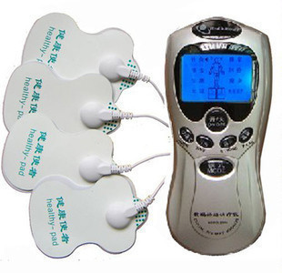
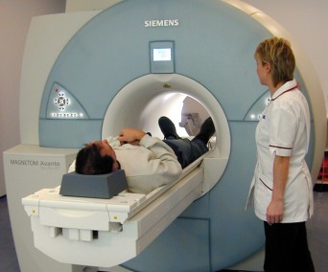
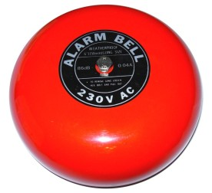

Magnets are needed to keep us active:
For centuries, compass has been faithfully providing guidance to travellers who would otherwise be lost in ocean sailing, forest adventuring, jungle trekking, etc…
In medical field, the magnetic therapy device and the magnetic resonance imaging (MRI) are two common machines used in rehabilitation…
Nowadays, our shopping cannot escape easily from the convenience of swiping with credit cards
A loud alarm sound will surely wake up all concerned…

Slide 5
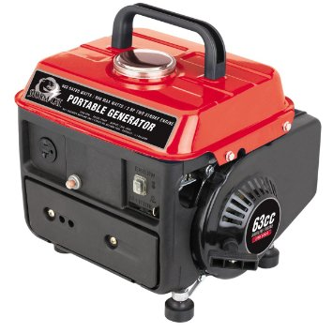
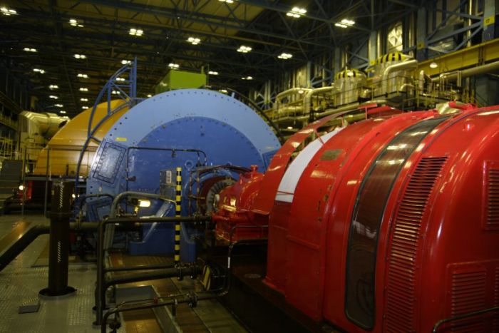
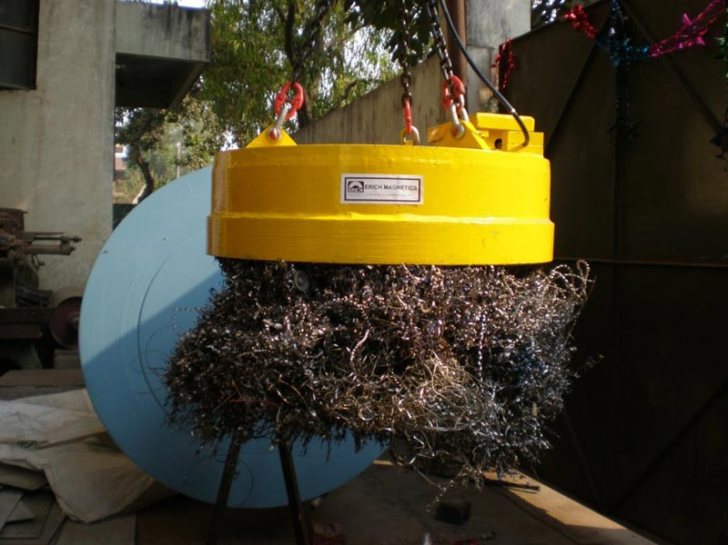
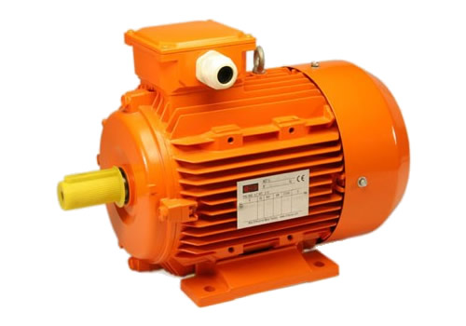
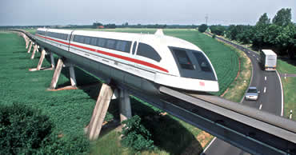
Magnets in power application:
A power generation plant needs magnets to keep its machine functioning.
It’s the same case for a portable generator.
An electric motor is another example.
A lifting magnet is energized to provide the lifting for ferromagnetic material in a scrap yard or a factory…
Magnetic levitation is an efficient way to move heavy vehicle such as a high-speed train.

Slide 6
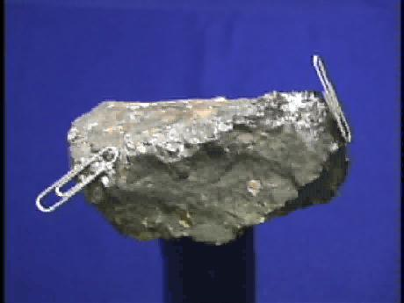
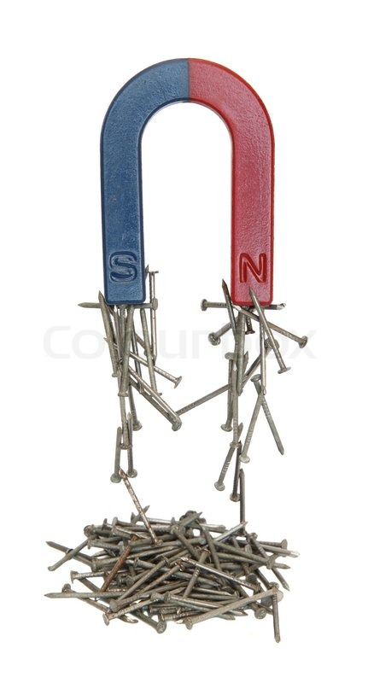
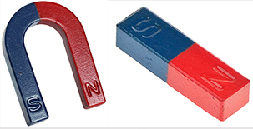
Properties of Magnets
The natural magnet, the lodestone or magnetite, possesses the force to attract or repel other lodestone nearby and started the imagination of minds across civilisations.
The most obvious feature of a magnet is that it attracts ferromagnetic material such as iron nails.
Ferromagnetic materials include iron, steel, cobalt, nickel and their alloys and they can become magnets themselves.
You may also notice that a magnet comes with two opposite poles: North pole and South pole.
Most common are bar and horse-shoe shaped magnets.

Slide 7
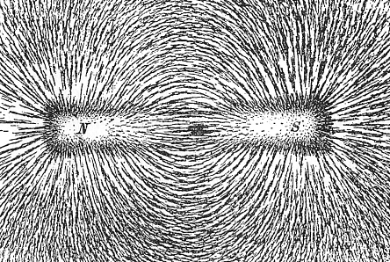
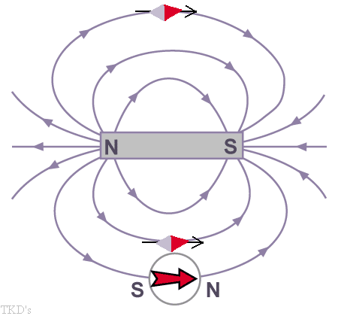
Properties of magnets
The pattern of magnetic field surrounding a bar magnet is exposed by using iron filings.
With the aid of compass needle, we observe that:
The field consists of lines of force.
These lines emanate from the north pole, radiate out into the external space and return at the south pole.
The lines continue to flow through the internal part of the magnet to form complete loops.
The loops do not intersect each other.
The lines are more concentrated at the two poles.

Slide 8
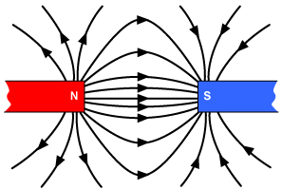
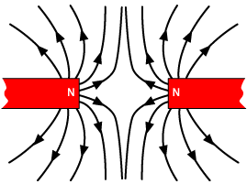
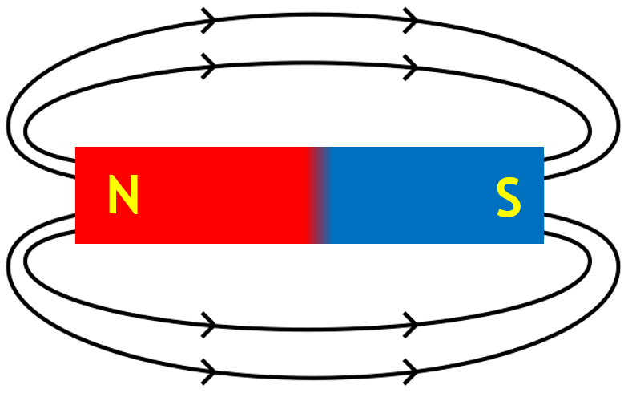
Properties of magnets
When unlike poles from two magnets are brought close to each other, they attract each other.
When like poles are brought close to each other, they repel each other.
These lines of force behave like elastic cords.
They tend to shrink to the smallest possible length in a state of tension.
Parallel magnetic lines of force traveling in the same direction repel one another.

Slide 9
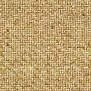
Shielding and Screening
The flux lines are not affected by the presence of a non-ferromagnetic material.
N
S
However, when a ferromagnetic material is present in the field, the flux lines are concentrating near it and flow through it as it provides a far more easy path.
Non ferromagnetic material
This property is applied to provide shielding of instrument from electromagnetic interference from external world or screening of its own interference to other circuit parts from within
N
S
Ferromagnetic material

Slide 10
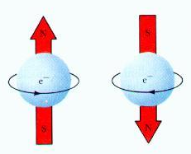
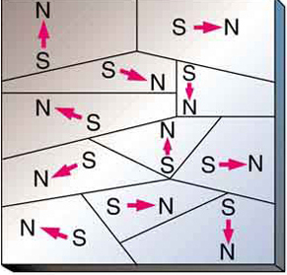
Magnetic Domains
The magnetic domain theory explains the magnetic properties of ferromagnetic materials.
In an atom, an electron spins as it obits around the nucleus.
The spinning direction can be either clockwise or counter-clockwise.
Its direction decides the magnetic polarity.
Those electrons spinning in the same direction grouped together.
They form a region called domain.
Many domains exist in a material and they are separated from each other by domain walls.
N
S
S
N

Slide 11
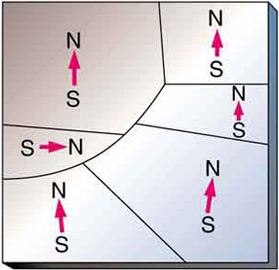
Magnetic Domains
The magnetic domains are responsible for the magnetic behaviours of the materials.
Under strong external magnetic field the domain walls shift responding to the change.
The microscope view of silicon steel material provides the evidence:
The dark areas and white areas are domains with opposite magnetic orientations.
They are shifting to align with the external magnetic field.

Slide 12
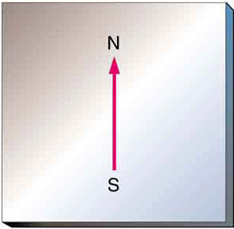
Magnetic Domains
Magnetization of a ferromagnetic material is the process whereby the hitherto randomly oriented magnetic domains are now uniformly oriented to produce a magnet.
S
N

Slide 13
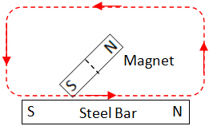
Magnetization Methods
Stroking method: Using one magnet
The steel bar is stroked with the same pole (say the South pole) of a permanent magnet from one end to the other end of the bar.
This process is repeated several times.
The steel bar will become a permanent magnet.
S
N

Slide 14
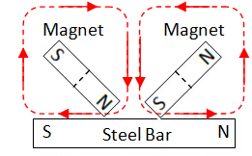
Magnetization Methods
Stroking method: Using two magnets
The stroking pole used in each magnet is opposite of the other.
They stroke the steel bar in opposite directions.
This process is faster as compared with one using one magnet.
S
N
Stroking method produces weak magnets.

Slide 15
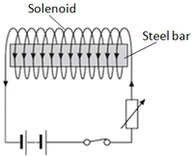
Magnetization Methods
Induction method: Using dc current
Connect the stretch of coil (called solenoid) to a dc supply.
Current flow produces a strong magnetic field within the solenoid.
The strong field magnetizes the steel bar placed inside it.
S
N
Induction method produces strong magnets.

Slide 16
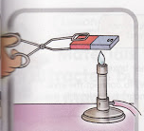
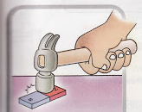
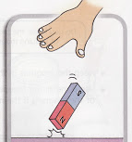
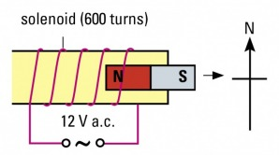
Demagnetization Methods
A magnet can be demagnetized by:
Heating the magnet up to its Curie temperature (Nickel: 385ºC; Cobalt: 1131ºC). When it cools down, the domains will align randomly.
Hammering or dropping and/or jarring the magnet will weaken its strength.
Place the magnet in a solenoid and connect it to an ac current to eliminate its strength.

Slide 17
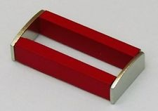
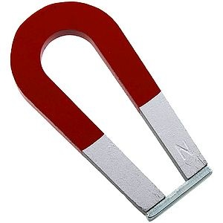
Storing Magnets
Magnets become weaker with time.
Bar magnets are kept using keepers across the ends.
The keepers are soft iron and provide the best path for the magnetic field.
Horseshoe magnets are kept in the similar way.
N
S
S
N
Keepers (soft iron)
N
S
Keeper (soft iron)

Slide 18
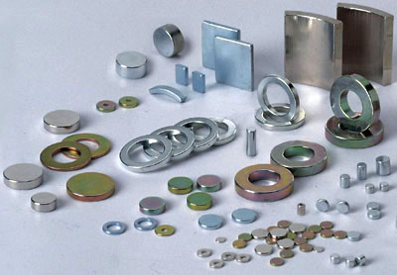
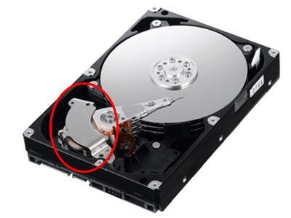
What other Magnets: Some examples
Neodymium magnets:
Permanent magnets made from an alloy of neodymium, iron and boron.
Applications that require strong permanent magnets, such as motors in cordless tools such as hand drill, hard disk drives and magnetic fasteners.

Slide 19
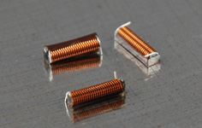
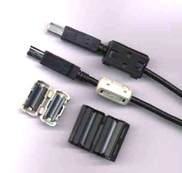
What other Magnets: Some examples
Ceramic (or ferrite) magnets:
Made of a sintered composite of powdered iron oxide and barium/strontium carbonate ceramic.
For use in electronic components such as radio antennas.
A ferrite bead suppresses high frequency noise in electronic circuits.

Slide 20
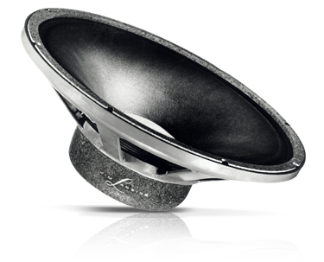
What other Magnets: Some examples
Alnico magnets:
Made by casting or sintering a combination of aluminium, nickel and cobalt with iron and small amounts of other elements added to enhance the properties of the magnet.
Alnico speaker does not need mains power to drive it.

Slide 21

What other Magnets: Some examples
Flexible magnets:
Composed of a high-coercivity ferromagnetic compound mixed with a plastic binder.
Fridge magnets to reminder stickers…

Slide 22
You have learned that
Magnets come with different compositions, shapes and sizes.
Magnets are deployed in many applications essential to our daily activities.
Magnetic domain theory explains the magnetic properties of ferromagnetic materials.Ferromagnetic materials can be magnetized using various methods.
Magnets can be weakened, demagnetized or destroyed by ways to disorient their magnetic domains.
Magnetic strength can be prolonged through proper keeping.

Slide 23
Coming Up Next
Introduction to Electromagnetism

